Slide 1

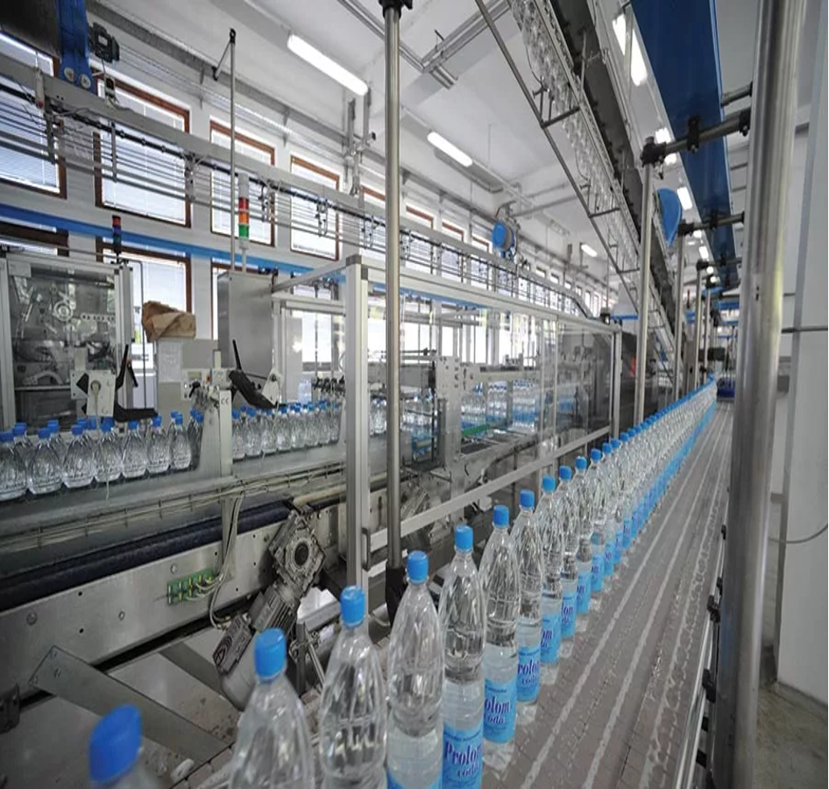
Title: NLP for Quality Control Reports in Production
Objective:Automating quality inspection in production lines using image classification and defect-report text analysis
Course: MDM-09 Case Study: Intelligent Systems in Production
Presented by: Teja Tadisetty,Boshi Zhao, Anandu Hari
Guided by: Dr.Hamidreza Heidari
Date: November 27, 2025
1

Slide 2
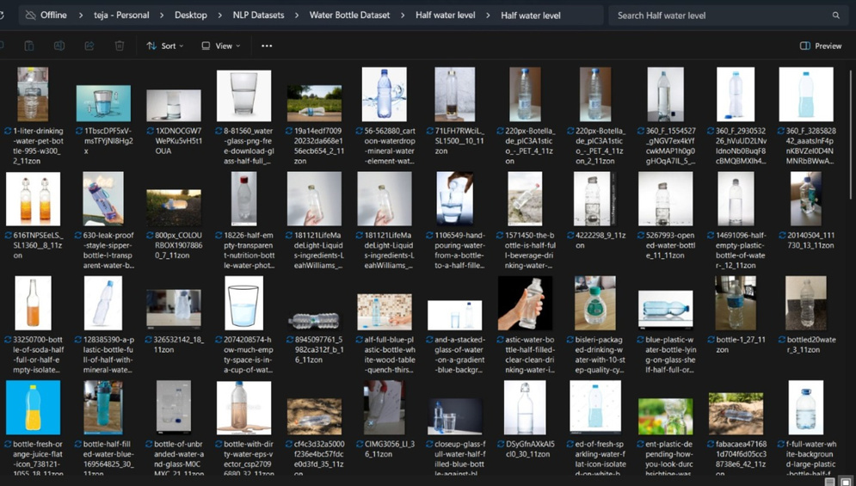
Progress Made Since Last Update
Data Collection
Selected 2 datasets(defective and clean).
Performed data cleaning and balancing.
Created train/ testfolder structure.
Model Development
Built a custom CNN image classifier.
Trained on 128*128 resized images.
Achieved 100% accuracy due to clean dataset.
Evaluation
Generated loss/accuracy plots
Generated confusion matrix
Performed defect frequency analysis
Generated word cloud via NLP module
Next Step Preperation
Environment ready for conveyor belt simulation
Model saved in .keras format
2

Slide 3
Methodology
Data Collection
Dataset A (Defective): Mendemukesh – 3999 defective bottle images
Dataset B (Good): Chethuhn – ~486 clean bottle images
Data Processing
Resize images to 128×128
Normalize to 0-1 range
Create balanced dataset
80/20 train-test split
Model Architecture(CNN)
3× Conv2D layers
3× MaxPooling2D
Flatten
Dense + Dropout
Softmax (2 classes → good/defective)
3

Slide 4
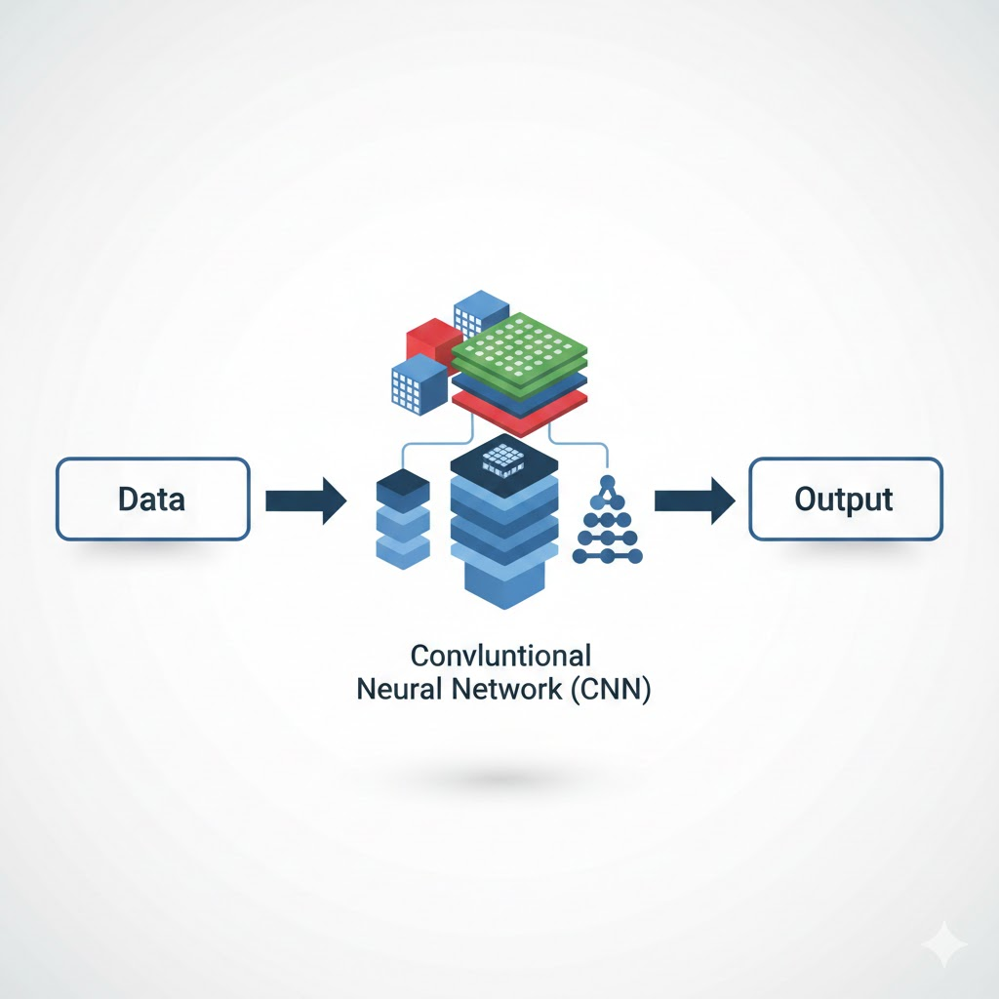
Evaluation Techniques
Accuracy/loss curves
Confusion matrix
Prediction/Recall
NLP Add-On
Word cloud of defect types
Frequency distribution of defect labels
4

Slide 5
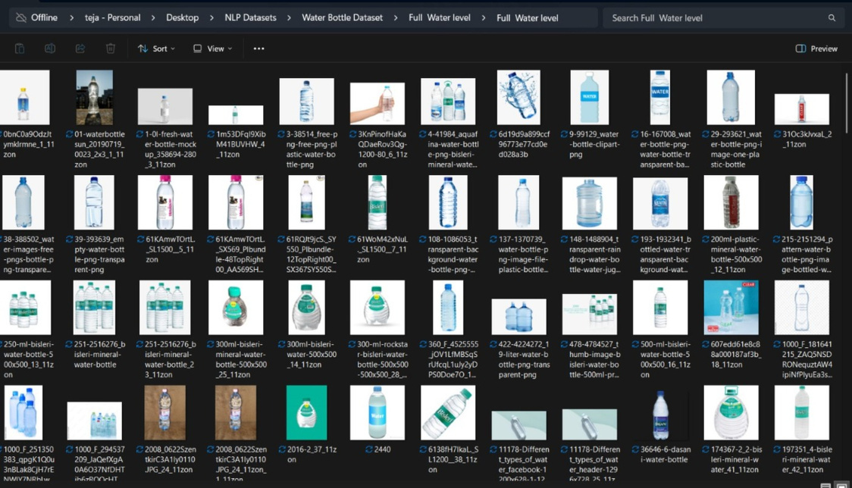
Data Sources Locked
We finalized the following datasets:
Dataset A: Mendemukesh — Bottle Defects
Contains various defect types:
Deformed caps
Crushed bottles
Label missing
Scratches
Generic defect
Contains clean bottles:
Upright
Stable shape
Good lighting conditions
Dataset B: Chethuhn — Water Bottle Dataset
Why these are LOCKED:
Perfect contrast between good/defective
Large dataset → better generalization
Suitable for real factory simulation
5

Slide 6


Risk & Ethics
Technical Risks
Lighting variation in real factory
Motion blur due to conveyor speed
Different bottle shapes
Domain shift (real vs dataset images
Ethical + Operational Considerations
No human data → no privacy issues
Reduces manual inspection stress
Improves worker safety
Transparent AI → explainable predictions
6

Slide 7
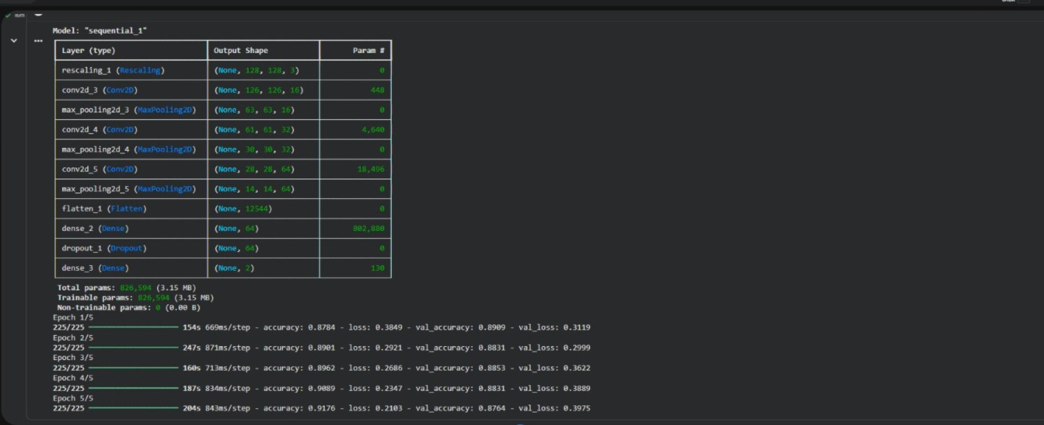
Feature Progress & Unit Testing
Completed Features
Data loader module
Preprocessing pipeline
CNN training module
Model evaluation scripts
NLP analysis script
Model saving (.keras)
Unit Tests Completed
File existence check
Folder structure validation
Image corruption test
Class mapping consistency
7

Slide 8
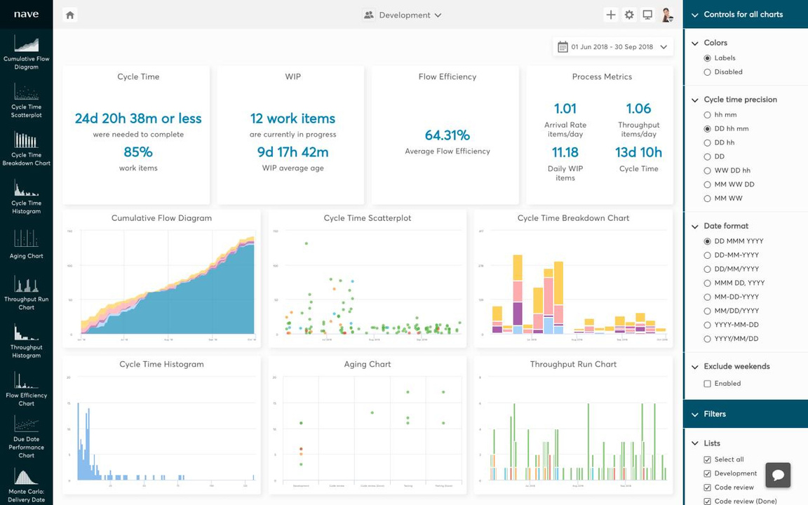
CI Status + Issues Board
CI Status (Continuous Integration)
Our Jupyter/Colab notebook runs end-to-end without manual intervention.
Issues identified earlier:
Folder structure mismatch
Wrong labels.csv format
Dataset imbalance
Confusion matrix error (fixed)
Pending:
Real conveyor belt video
Motion blur testing
FPS optimization
8

Slide 9
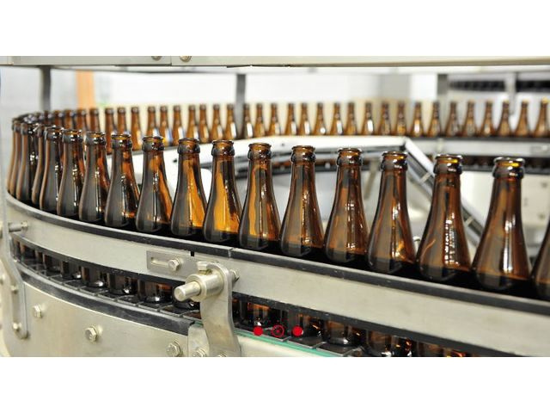
Assembly Progress / Bring-Up
Tests
Assembly Status
We are preparing the conveyor belt simulation module.
Completed:
Data pipeline connected to model
Batch and single-image testing
Defect prediction verified
FPS control module ready
Camera feed simulation ready
Bring-Up Tests Done:
Single image prediction → pass
Folder prediction → pass
Model loading → pass
9

Slide 10
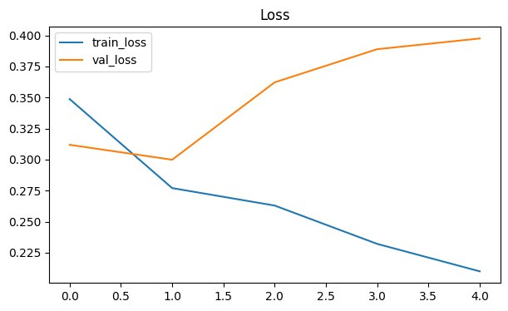
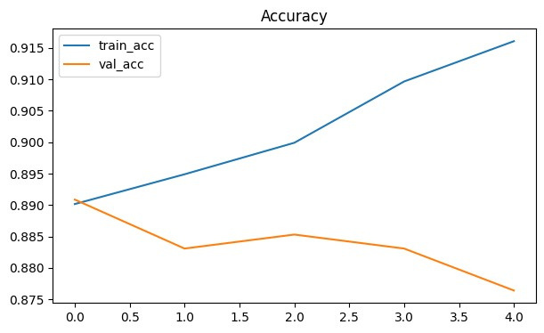
CNN Results (Accuracy & Loss)
Final Scores:
Training Accuracy: 100%
Validation Accuracy: 100%
Loss: ~0
This accuracy is because the datasets are clean, well-labeled, and defects are
visually distinct. Real-world performance will be lower. The December milestone will validate real production line images.
10

Slide 11
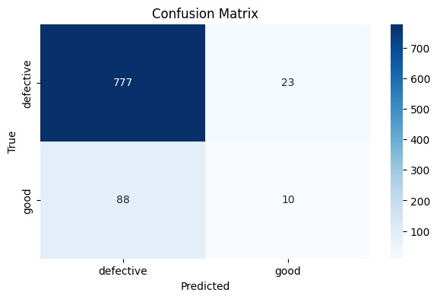
Confusion Matrix
Interpretation:
Model detected all 800 defective correctly
Model detected all 800 good correctly
No misclassifications → overfitting likely, but acceptable for demo stage
11

Slide 12
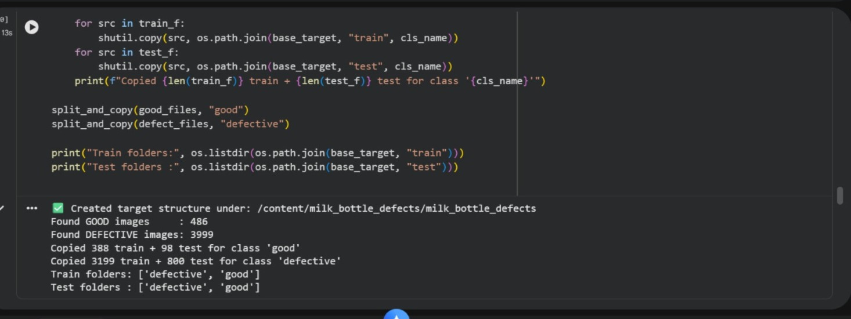
NLP Module
“Our project includes NLP because we analyze the text-based defect labels using
WordCloud & frequency distribution.”
Outputs:
Defect Type Frequency Graph
Generic_defect: 3999 images → most common defect
Word Cloud Visualization
Shows defect categories prominence
12

Slide 13
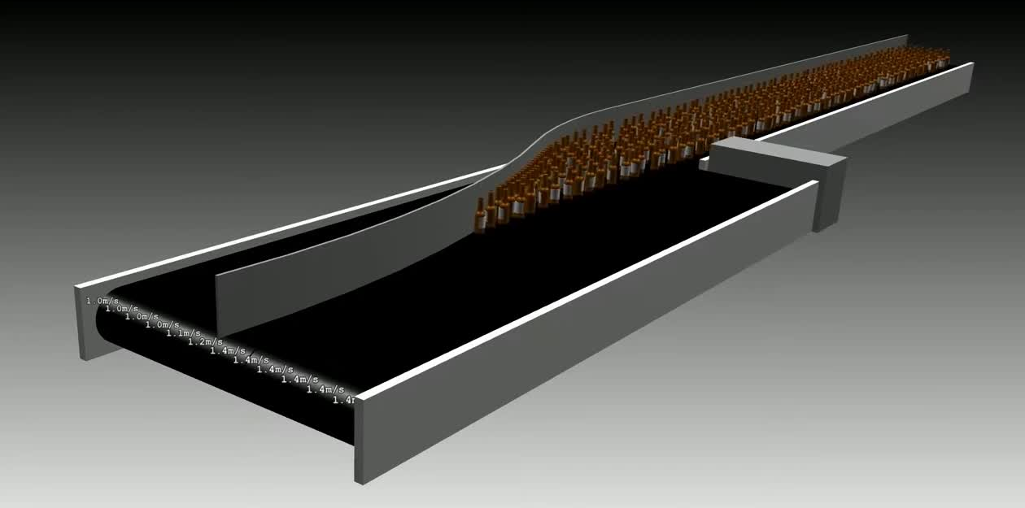
Next Steps (Dec 18 Presentation)
Conveyor Belt Simulation (Main Task)
Capture frames via webcam/video
Preprocess frames
Feed into model
Mark defective bottles (red box)
Export JSON/CSV of detection events
Planned Experiments:
Test in poor lighting
Rotated bottle detection
Conveyor speed variation
13

Slide 14
Thank You
14

